Slide 1



Slide 2



Slide 3
About the new Version
Hey, how's it going? This is another edition of the Guidebook. However, I understand that not everyone may be inclined towards this version due to the increased use of animations and transitions. It's simply a new experiment for me and all of you, offering a fresh experience.
“What would life be if we had no courage to attempt anything?”
it is always recommended to consult the course syllabus or communicate with the instructor for the most accurate and up-to-date information on the grading and coursework structure.
25%

Slide 4
About the new Version
As you may have guessed, this is indeed a special edition. Congratulations! You have reached the halfway mark in becoming a Biomedical Engineer.
50%

Slide 5
Table of contents
01
02
03
04
05
06
Bio- measurements
Biomechanics II
DataBase
Numerical Methods
Biostatistics
Electronics II

Slide 6

01
01
Bio-Mechanics

Slide 7
Part 1: Fluids
While this course may have gained a negative reputation within our department, it is worth noting that if you invest even a small amount of effort into practicing it, you will discover that it is actually one of the easiest courses.
Mastering the fluid part is primarily based on comprehending a set of straightforward equations and applying them to real-life problems. Attending either the lectures or sections is crucial, with sections being particularly essential. This is because (TAs) in the sections go through practice problem sheets, which are frequently encountered in exams.

Slide 8

Part 2: Thermodynamics
Sections play a significant role in reinforcing and supplementing the lecture material, ultimately contributing to a more comprehensive understanding of the subject.
Give equal importance to all aspects of the course, including reports, as they might contain exam questions. Solving previous years' exams is crucial for familiarizing yourself with the exam format and practicing relevant problems.
the course hinges on paying close attention to Dr. Atef's lectures and taking thorough notes. It is crucial to actively focus during these lectures as they form the foundation of the principles being taught.

Slide 9


External Resources
Fluids
Thermodynamics
Full Roadmap
SBME25 Sections
Eng. Hamza Sections
SBME24 Sections
SBME25 Sections
EPE25 Sections

Slide 10
Bio- measurments
02

Slide 11

Overview
The bio-measurement course provides an overview of various types of sensors utilized in the field. These sensors encompass a range of measurements including pressure, temperature, volume, mass, volume flow rate, and velocity. You will delve into the principles, working mechanisms, and applications of these sensors within the context of bio-measurement. Understanding how to accurately measure and interpret these parameters is important in fields such as biomedical engineering, healthcare, and biological research. By the end of the course, you will have a solid foundation in bio-measurement techniques and the ability to select and utilize appropriate sensors for different applications.
03

Slide 12

03
03
Database

Slide 13
Overview
You will delve into the fundamental aspects of Relational Diagrams, SQL, relational algebra, file structure, and B-trees. SQL, the standard language for managing relational databases, will be thoroughly explored to enable you to manipulate and query data effectively. The course will also cover relational algebra, providing a formal foundation for understanding and analyzing relational databases. Additionally, you will learn about file structures and their role in efficient data storage, as well as the utilization of B-trees for indexing and searching large datasets.

Slide 14
4 Parts
01
02
03
04
To understand ER diagrams and schemas, it is sufficient to grasp the meaning of each shape and the relationships between entities. It is essential to be familiar with the process of converting an ER diagram into relational schemas.
The SQL part primarily covers essential commands such as table creation and column selection, with a particular emphasis on the "select statement" that frequently appears in exams. I recommend a concise course available on the "learn-sql" site, which can be completed within a few hours.
Relational algebra serves as an alternative method for expressing SQL commands without actual coding. it is advisable to watch tutorials that cover the different symbols and their respective usage. This will help you develop familiarity with the language.
structures, emphasizing theoretical knowledge regarding how different hardware devices handle data. It is essential to understand data storage and retrieval. B-trees, another form of binary search trees designed for indexing and managing large datasets.

Slide 15
4 Parts
01
02
03
04
To understand ER diagrams and schemas, it is sufficient to grasp the meaning of each shape and the relationships between entities. It is essential to be familiar with the process of converting an ER diagram into relational schemas.
The SQL part primarily covers essential commands such as table creation and column selection, with a particular emphasis on the "select statement" that frequently appears in exams. I recommend a concise course available on the "learn-sql" site, which can be completed within a few hours.
Relational algebra serves as an alternative method for expressing SQL commands without actual coding. it is advisable to watch tutorials that cover the different symbols and their respective usage. This will help you develop familiarity with the language.
structures, emphasizing theoretical knowledge regarding how different hardware devices handle data. It is essential to understand data storage and retrieval. B-trees, another form of binary search trees designed for indexing and managing large datasets.

Slide 16
4 Parts
01
02
03
04
To understand ER diagrams and schemas, it is sufficient to grasp the meaning of each shape and the relationships between entities. It is essential to be familiar with the process of converting an ER diagram into relational schemas.
The SQL part primarily covers essential commands such as table creation and column selection, with a particular emphasis on the "select statement" that frequently appears in exams. I recommend a concise course available on the "learn-sql" site, which can be completed within a few hours.
Relational algebra serves as an alternative method for expressing SQL commands without actual coding. it is advisable to watch tutorials that cover the different symbols and their respective usage. This will help you develop familiarity with the language.
structures, emphasizing theoretical knowledge regarding how different hardware devices handle data. It is essential to understand data storage and retrieval. B-trees, another form of binary search trees designed for indexing and managing large datasets.

Slide 17
4 Parts
01
02
03
04
To understand ER diagrams and schemas, it is sufficient to grasp the meaning of each shape and the relationships between entities. It is essential to be familiar with the process of converting an ER diagram into relational schemas.
The SQL part primarily covers essential commands such as table creation and column selection, with a particular emphasis on the "select statement" that frequently appears in exams. I recommend a concise course available on the "learn-sql" site, which can be completed within a few hours.
Relational algebra serves as an alternative method for expressing SQL commands without actual coding. it is advisable to watch tutorials that cover the different symbols and their respective usage. This will help you develop familiarity with the language.
File structures, emphasizing theoretical knowledge regarding how different hardware devices handle data. It is essential to understand data storage and retrieval. B-trees, another form of binary search trees designed for indexing and managing large datasets.

Slide 18
External Resources
ER & SQL &
RELATIONAL ALGEBRA
File Structure & B-trees
DBMS - Neso Academy
SQL Basics – learnsql.com
Desoky – Beginner course
ER to Schema
Fahd Gamal – File Organization
B-Trees
B-Trees - Deletion
04

Slide 19
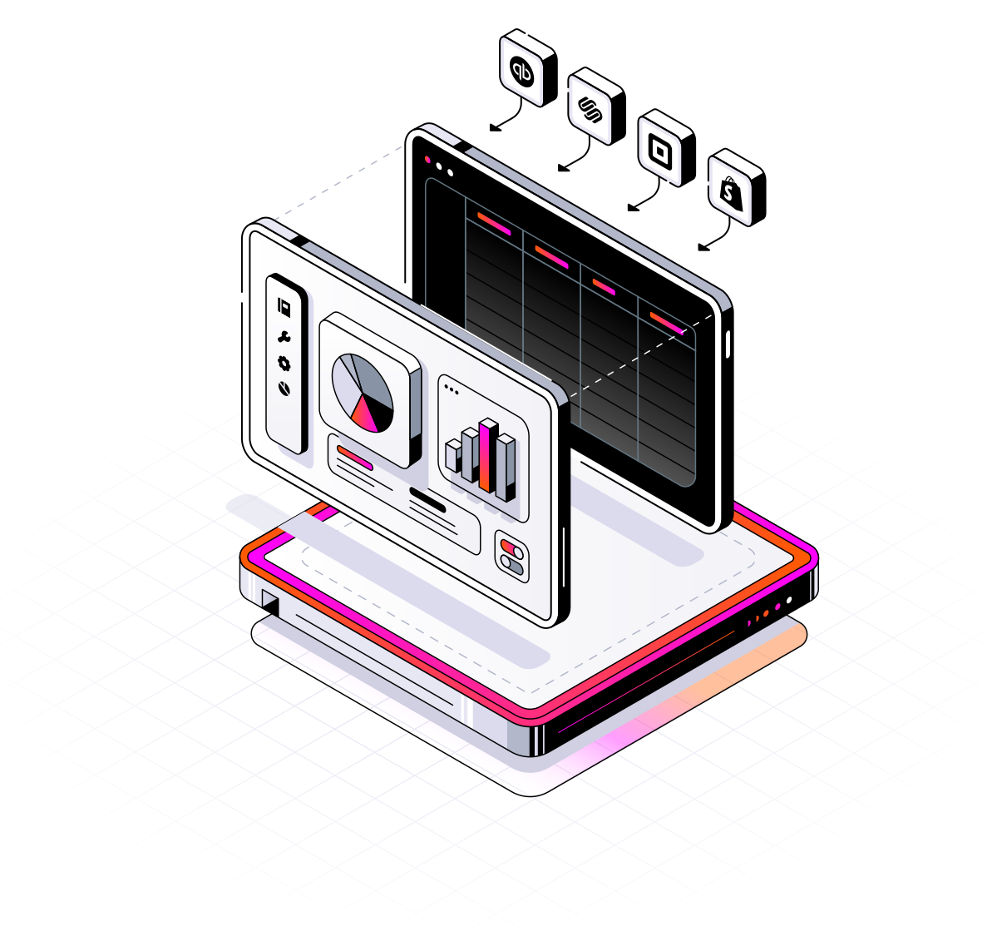
04
04
Biostatistics

Slide 20
Probability & statistics
the course mainly divided into two main parts:
Before Mid After Mid
This section covers general rules of probability and various types of probability, including marginal, conditional, and joint probability. It is crucial to pay close attention to this part, as the upcoming content builds upon these foundational concepts.
In the second part, the focus shifts to exploring the correlation between random variables and the application of linear regression. the differentiation between samples and populations, along with the corresponding rules applicable to each.
Lastly, hypothesis testing which involves assessing the validity of assumptions and adjusting methodology accordingly.

Slide 21
Sections Final project
Attending the sections is crucial for gaining a deeper understanding of the course concepts. The TA's approach emphasizes comprehension over memorization of problem-solving techniques. It is important to make the most of the sections to fully grasp the material and optimize your learning experience.
There may be some changes in the project next years, but we had two options either choose an idea about binary classification or linear regression.
In the project, you will apply various statistical methods you learned throughout the course and of course you will need more advanced knowledge which you will gain on your own.

Slide 22
External Resources
Before Mid
After Mid
05
DR. Ahmed Hagag
The Organic Chemistry Tutor
SBME25 - Sections
MIT – Probabilistic Systems
The Organic Chemistry Tutor
Hypothesis Testing

Slide 23

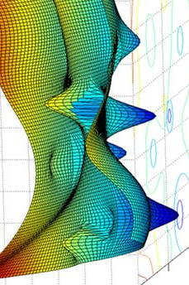
05
05
Numerical Methods

Slide 24
Introduction to Deep Learning
I am excited to introduce my favorite course to you. Unlike previous years, Dr. Mina has made significant changes to the content, making it more practical and aligned with current advancements. If you have no prior experience in deep learning (DL), fear not, as you will acquire a wealth of knowledge in just a few lectures. However, it is possible that some of you may initially face challenges due to the introduction of unfamiliar topics. I assure you that if you dedicate effort to each lecture and study diligently, you will excel in the course and achieve excellent grades. So, embrace the coding aspect and enjoy the journey!

Slide 25
Topics
1
2
3
Coding
Exams
In a nutshell, the course covers several key topics. It begins with optimization techniques such as Gradient Descent and Stochastic Gradient Descent. Backpropagation is introduced as a method for adjusting and updating a model's parameters. PyTorch, a Python library, is utilized for efficient tensor manipulation and incorporates built-in methods. Supervised learning, a type of machine learning, is explored and its applications, particularly in classification, are emphasized. Lastly, the course delves into constructing your own auto-grad engine and employing different techniques to traverse it.

Slide 26
Topics
2
1
3
Coding
Exams
Undoubtedly, coding is a crucial component of the course. Deep understanding of each concept is best achieved through hands-on coding, even if you start by replicating code from lecture videos. It is essential to make adjustments and improvements to the code on your own. This active engagement with coding will significantly enhance your learning experience. Relying heavily on shared notebooks from your colleagues should be avoided, as the process of writing and modifying code independently will be much more beneficial in building your skills and comprehension.

Slide 27
3
1
2
Topics
Coding
Exams
While I cannot confirm if the classwork structure will remain the same, it appears that, there were only four quizzes, with the majority of grades determined by the final exam. The quizzes seemed to assess your understanding of code and required making adjustments to it. there were no problem-solving sheets or additional exercises.

Slide 28
External Resources
Videos
Notebooks
The following repository contains all lectures in addition to All Quizzes and Final Revision
GitHub - Repo
Python for data science
Statquest – Neural Networks
Hesham Asem – Career Track
3Blue1Brown – Neural Network
06

Slide 29

06
06
Electronics
II

Slide 30
01 Analog
02 Digital
The analog electronics course offers a comprehensive exploration of building amplifiers using MOSFET and BJT technologies. you will delve into the fundamental principles, circuit configurations, and design considerations associated with these amplifier types. Emphasis is placed on understanding the behavior of MOSFET and BJT amplifiers in terms of gain, input/output impedance, and frequency response. Additionally, you will learn techniques for analyzing and optimizing amplifier performance, including the impact of capacitors and resistors on frequency response. By the end of this part, you will possess a solid understanding of analog amplifier design and its frequency response characteristics.

Slide 31
01 Analog
02 Digital
The digital electronics course covers a wide range of essential topics. you will explore CMOS logic circuits, focusing on the design and analysis of digital circuits using Complementary Metal-Oxide-Semiconductor technology. Transistor sizing techniques will be discussed, enabling you to optimize circuit performance. Power dissipation and reduction strategies will also be addressed. The course will delve into memory and clocking circuits, covering the operation and design principles of various types of flip-flops and related devices. you will gain knowledge in designing and analyzing counters and registers, which are fundamental components in digital systems.

Slide 32


سيبك من الكلام الفورمال اللي فات، اكيد انت شوفت اليكترونكس 1 وان شاء الله تكون عديت منها بخير. اول جزء الترم ده تكملة للترم الأول -لو الدكتور ملحقش يخلصه- ممكن تتصدم في البداية تحس انه صعب لكن مع الحل والكويزات هتجمع القوانين وهتفهم كل جزء مطلوب فيه ايه، مهم انك تكون حافظ وفاهم القوانين لأن مفيش لعب كتير مجرد تغير في شكل الكونفجرايشن.
.MAX & MIN values وامتى تجيب ال AC مهم جدا تفهم جزء ال
شابتر 10 مهم بس تعرف كل القوانين جت ازاى وازاى تعوض بس وهتعدي منه عشان مفيهوش فهم كتير ومتشغلش فيه دماغك عشان تعدي.
اخر حاجة الديجيتال، جزء كبير منه معتمد على اللي انت خدته في كورس اللوجيك في سنة أولى، وبالرغم انه جزء كبير والدكتور بيحاول يخلصه بسرعة لكن سهل انه تلمه -متراكمهوش- معتمد انك ممكن تحفظ شكل كام رسمة وازاى تعدل او تضيف عليها.
القوانين بتاعة الديجيتال مش كتيرة لكن ممكن تلغبط لأن مفيش مسائل كتير، فحاول تفهم ازاى تعوض صح في كل قانون. أخيرا مهم انك تحل امتحانات السابقة خاصة في الجزء ده لأنها بتتكرر كتير.

Slide 33
THANKS
Mohamed Abo-Mandour
Chat GPT

